Slide 1



Supply chain Analysis
View in Power BI
Last data refresh:
4/23/2024 1:00:03 AM UTC
Downloaded at:
4/23/2024 1:10:25 AM UTC

Slide 2
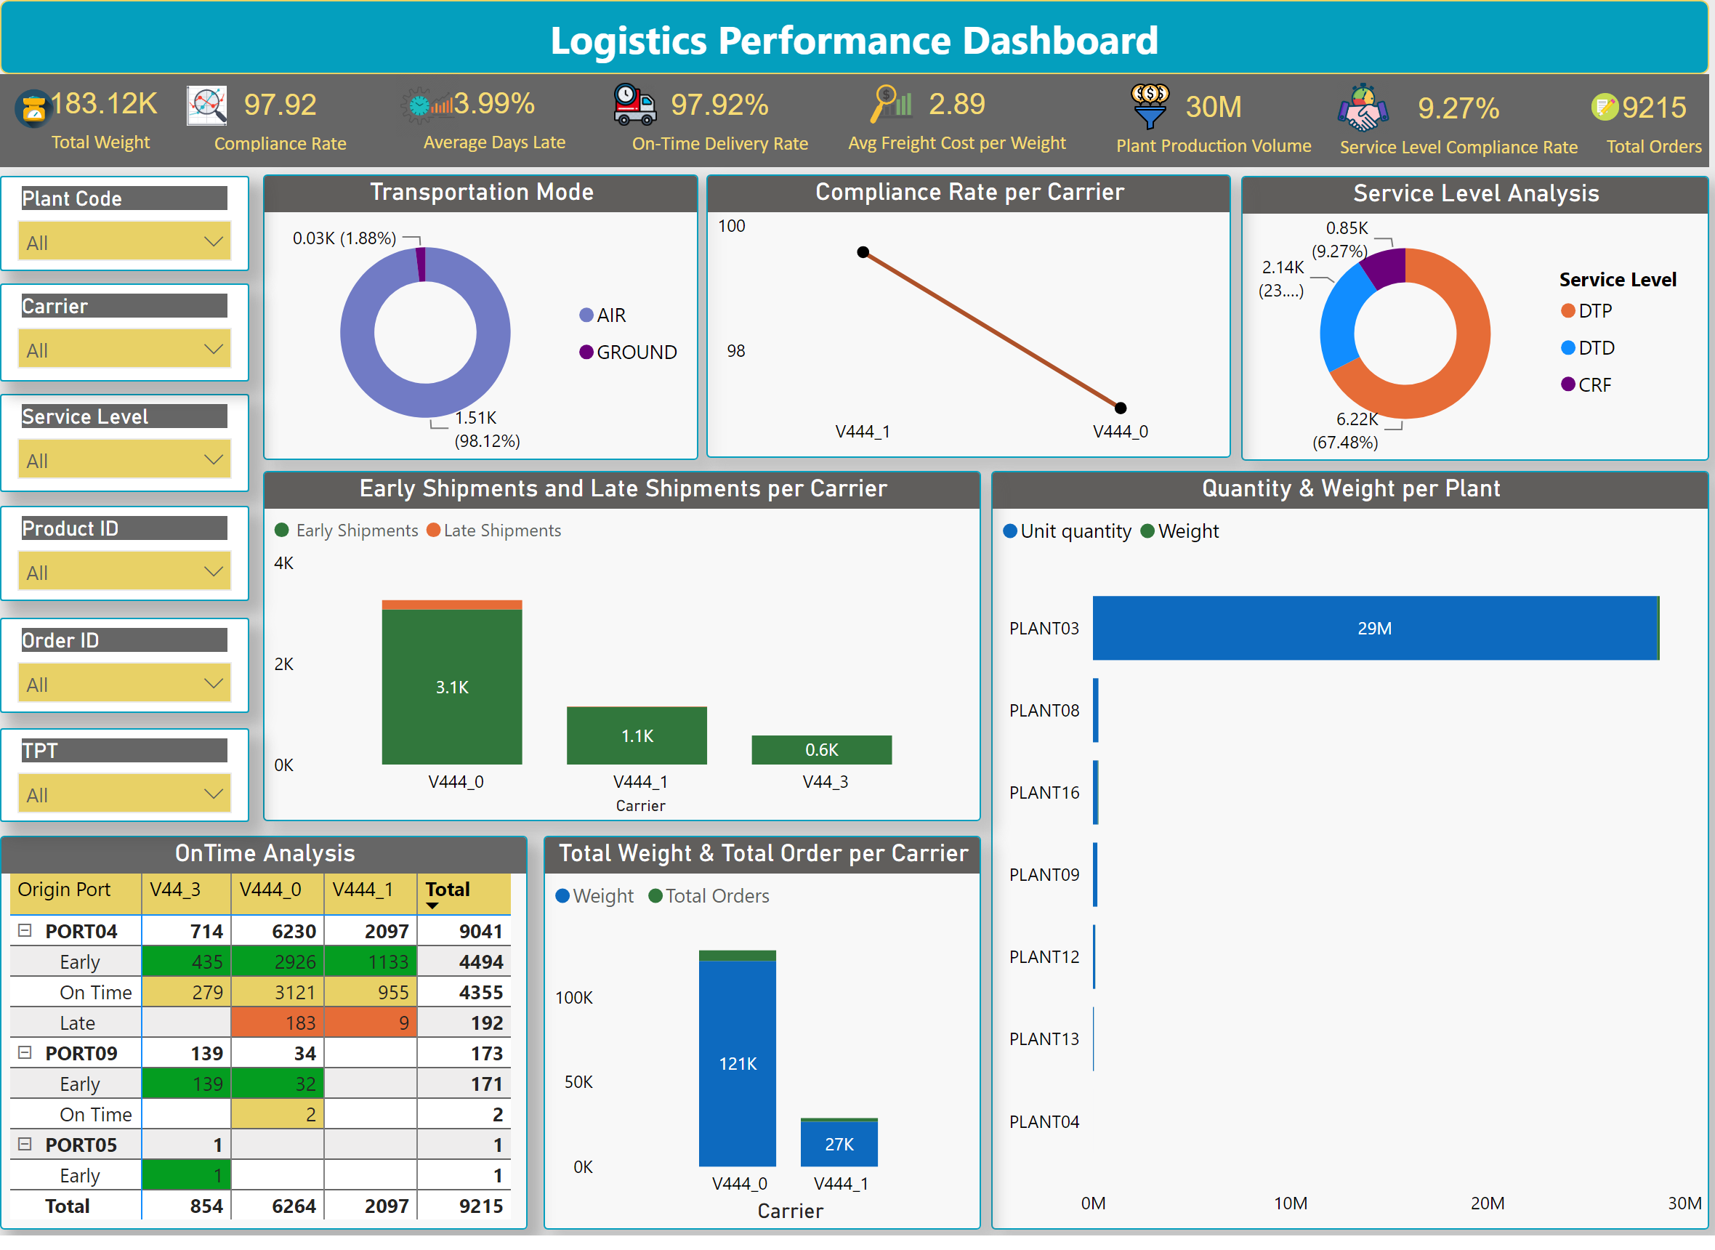
Supply Chain Analysis
Notes:
Transportation Mode
No alt text provided
slicer
No alt text provided
slicer
No alt text provided
slicer
No alt text provided
textbox
No alt text provided
slicer
No alt text provided
slicer
No alt text provided
Service Level Analysis
No alt text provided
Compliance Rate per Carrier
No alt text provided
Quantity & Weight per Plant
No alt text provided
Early Shipments and Late Shipments per Carrier
No alt text provided
OnTime Analysis
No alt text provided
Total Weight & Total Order per Carrier
No alt text provided
slicer
No alt text provided
textbox
No alt text provided
image
No alt text provided
card
No alt text provided
image
No alt text provided
card
No alt text provided
image
No alt text provided
card
No alt text provided
image
No alt text provided
card
No alt text provided
image
No alt text provided
card
No alt text provided
image
No alt text provided
card
No alt text provided
image
No alt text provided
card
No alt text provided
image
No alt text provided
card
No alt text provided

Slide 3
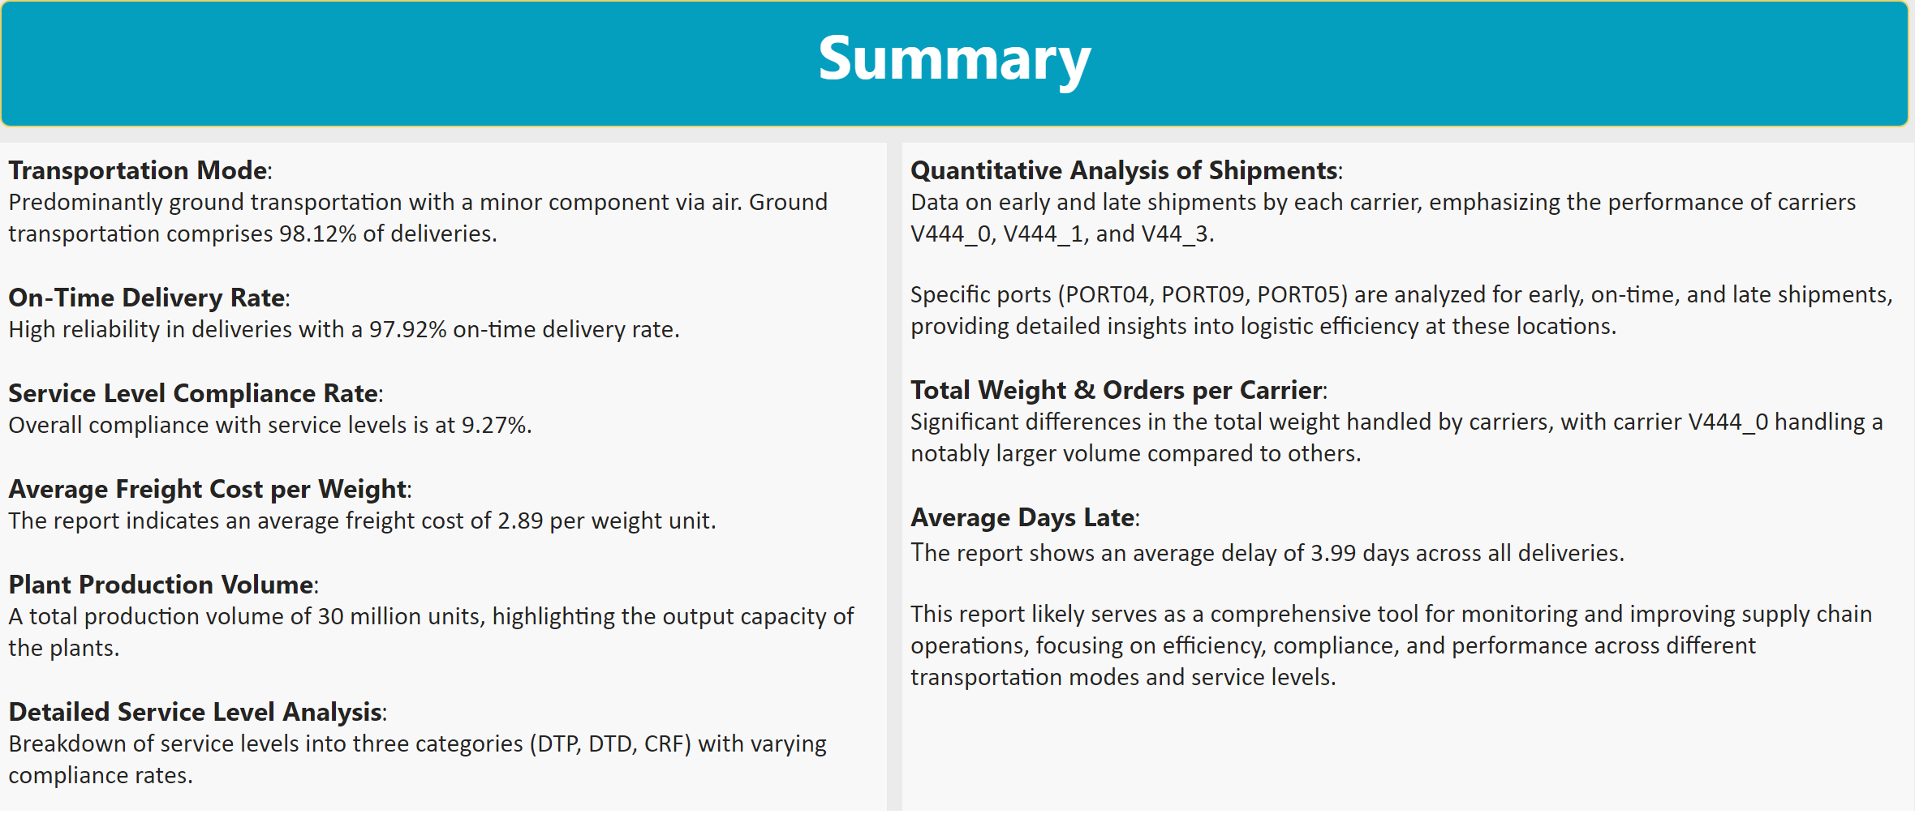
Summary
Notes:
textbox
No alt text provided
textbox
No alt text provided
textbox
No alt text provided

